Slide 1
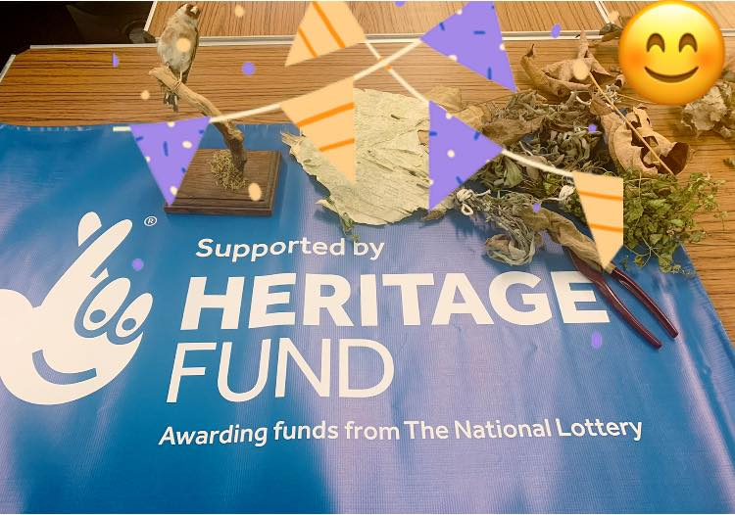
Sensing the Wild - connecting visually impaired people to nature
wellbeing outcomes
P.Bennett 2020
Notes:
1

Slide 2
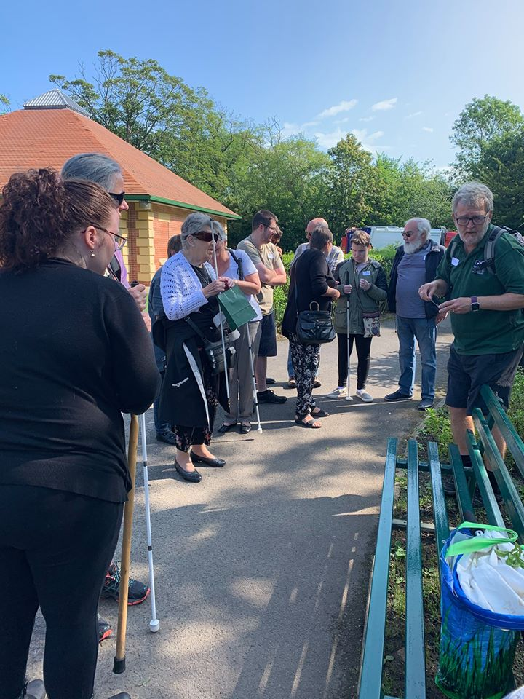
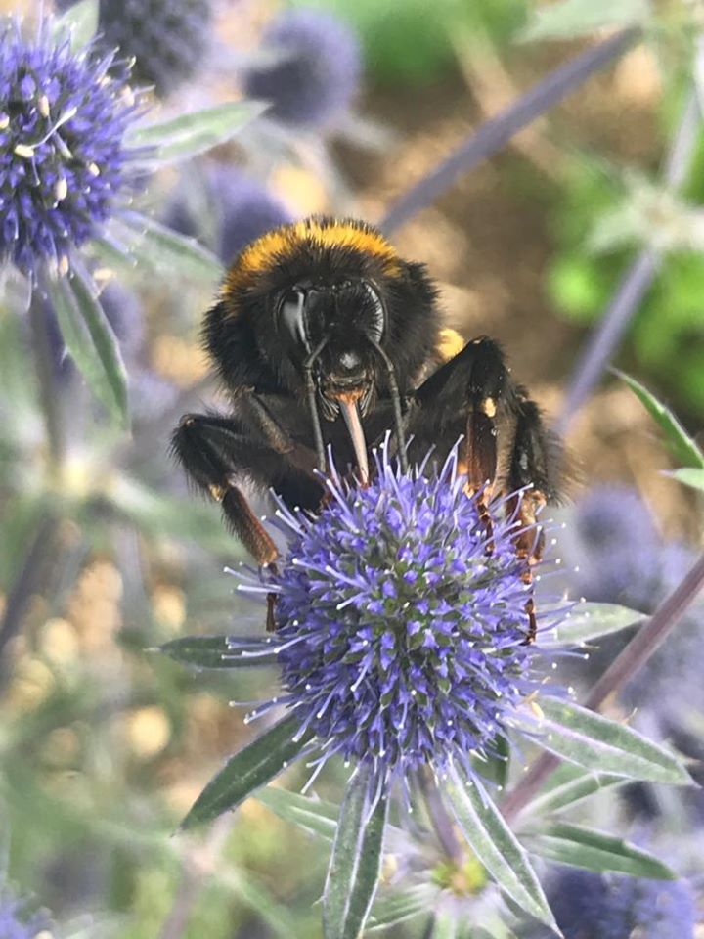
A group of people setting off on a walk in the park A close up of a bee on a blue spiky flower

Slide 3
Sensing the Wild – about the project
Our idea was to facilitate and support walks for Blind and visually impaired people, using all the senses to learn about nature and wildlife in each of the four seasons.
People do not fall into defined categories and some individuals may also have other long term conditions, mental health and physical mobility issues.
The TVWT experts are leading a series of indoor workshops for us for four groups followed by a walk the following week.
Notes:
3

Slide 4
Sensing the Wild – who we worked with
Tees Valley Wildlife Trust
Friends groups linked to Parks and Woods
Visually Impaired social groups and organisations
HLF – for advice and guidance
Notes:
4

Slide 5
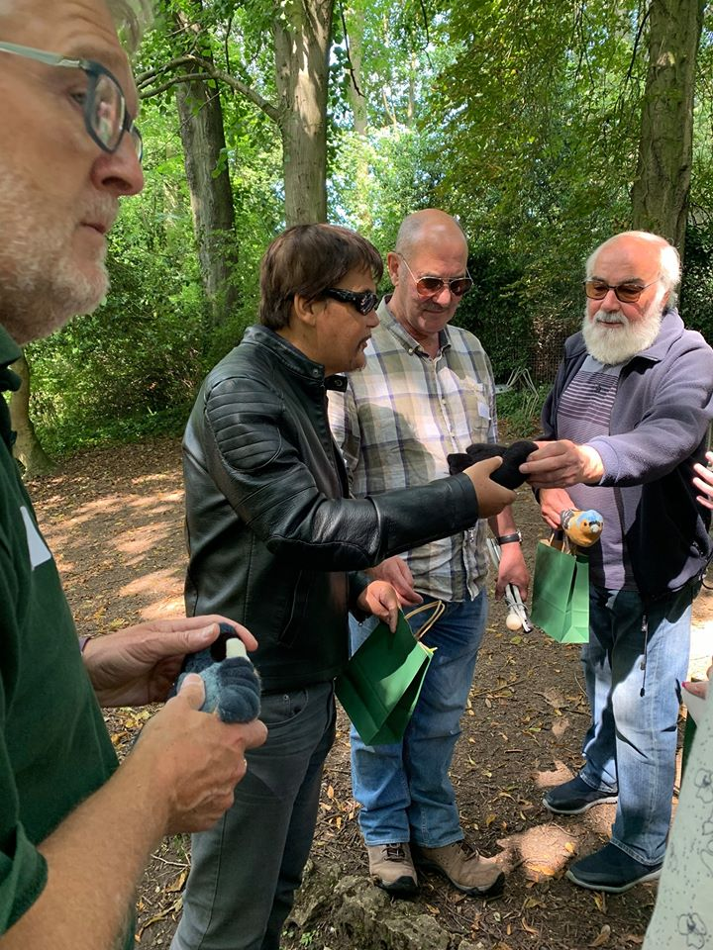
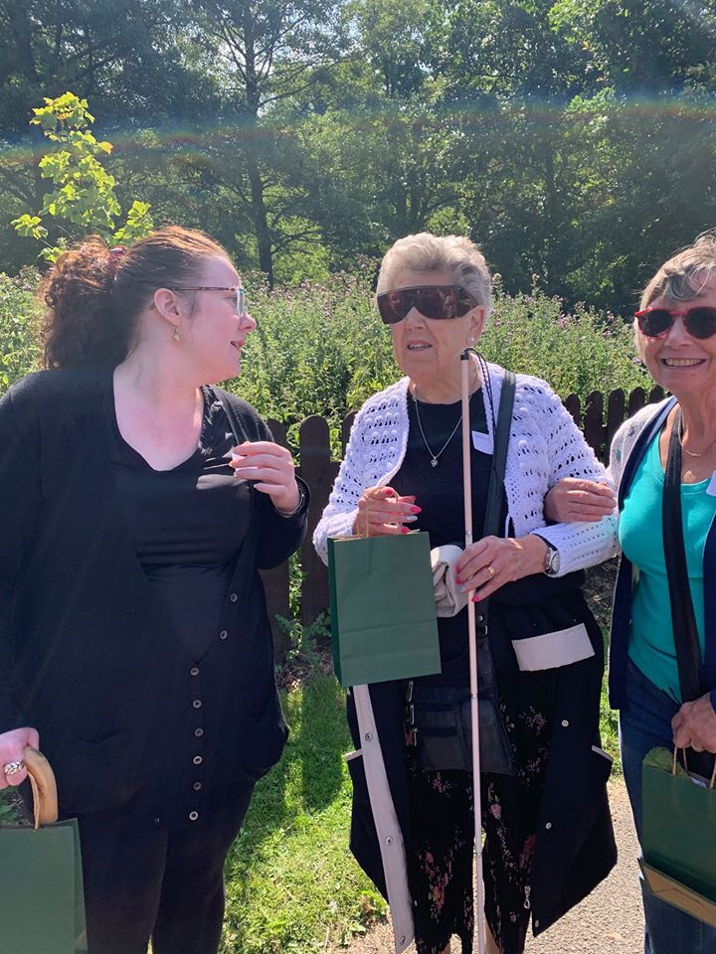
A group listening to bird song in the wood and handling soft toy birds that sing! 3 Ladies chatting and enjoying the sunshine

Slide 6
Sensing the Wild – improved wellbeing for participants
Reducing isolation
Social inclusion /contact with others in safe company
Access to outdoors and fresh air
Increased physical activity/ improved health
Improved appetites
Stimulating conversation/ new friends
Increasing knowledge about nature and local heritage
Notes:
Comments from our two participants from Darlington Social Club
6

Slide 7
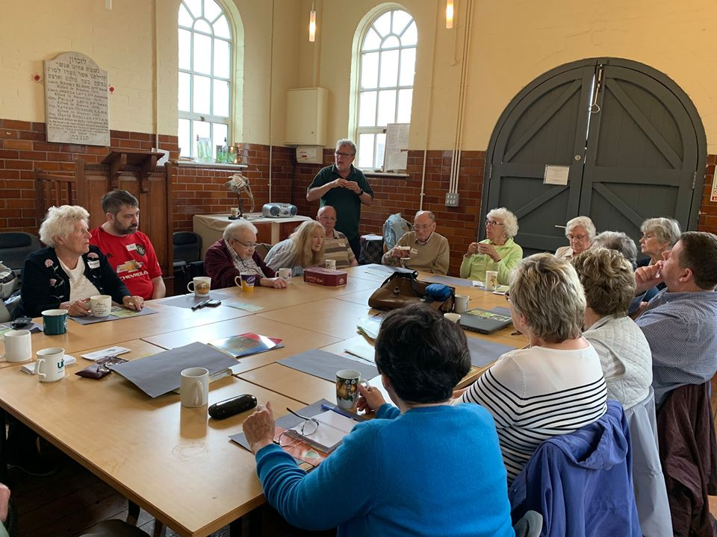
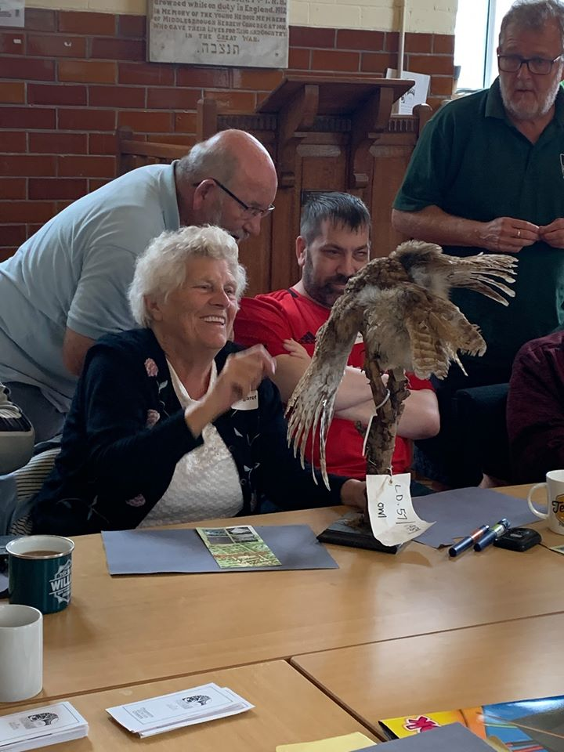
A workshop in full swing – led by Steve Ashton of TVWT Getting up close to an owl with outspread wings

Slide 8
Sensing the Wild – benefits for us all
Sighted guide training for Friends groups
Improved understanding of sight loss conditions through training and engagement with visually impaired people
Learning about the history and ecology of the parks and wood
Enjoyment of the activities – we also had exercise and fresh air!
Ripple effect –benefits for a wider range of people, friends, families, carers, local organisations etc.
Notes:
8

Slide 9
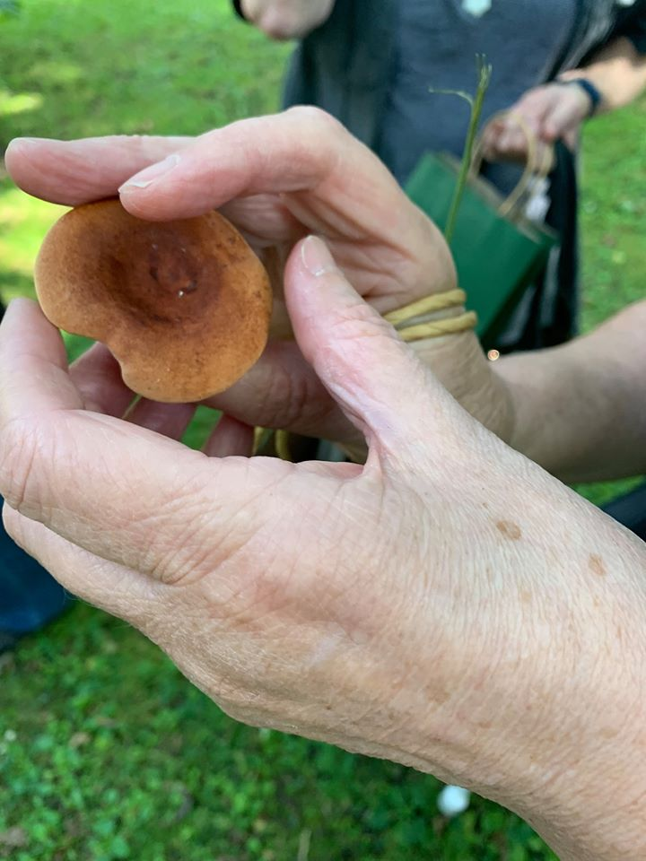
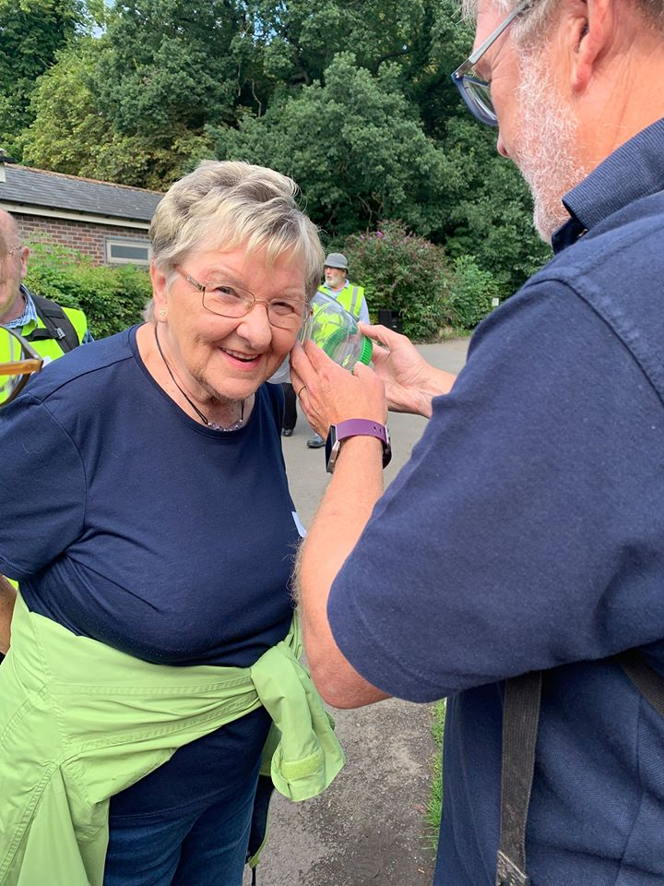
Close up of hands holding a fungus Picture of a person listening to a bee buzzing in a jar

Slide 10
Sensing the Wild – benefits for GFI
As a social enterprise providing information and advice about how to stay independent and active for people experiencing short and long term impairments we are able to extend our service to more people.
Improved profile – BBC Countryfile and local radio- and being here today….
Been able to reach out to others – going to visit a group in Leeds and we will produce a project model for others to use
We have attracted volunteers to train as sighted guiders and assist us with our activities
We are able to share our knowledge of independent living equipment with a wider audience
Notes:
10

Slide 11
Sensing the Wild - legacy
Disability Awareness and Guiding training for Friends groups, project workers and volunteers
Accessibility to sites improved– through dialogue with Friends groups - made more suitable for people with low sight with info about the sites in larger print or other formats.
Linking local people to others with sight loss through the guiding/ visits
Exercise/ improved health/ wellbeing for participants
Social inclusion
Heritage – learning
Keepsake boxes of collected items and leaflets, smells, touch, to stimulate memories
Notes:
11

Slide 12
Sensing the wild – challenges
Pre-project consultation and planning process
Understanding individual needs – visual and mobility
Recruiting a Sighted Guide trainer
Transport for participants and equipment provision
The weather and condition of terrain!
Catering and facilities provision at different venues
Notes:
12

Slide 13
Sensing the wild - Evaluation
Photographs of walks and workshops
Audio recording of feedback after workshops and walks
Keeping records of comments, numbers of participants and Friends / other volunteers
Asking about wellbeing at the start and end of the sessions
Asking the Friends volunteers about their experience and observations
Notes:
13

Slide 14
Thank you to National Lottery Players and the Heritage Lottery for funding our project.
Contact details
www.goingforindependence.org
Email: going4independence@ymail.com
Tel: 01287 204204
Follow our project on Facebook: GoingFor Independence.
Come and join us on one of our Springtime walks!
Notes:
14

